Slide 1
Entropy not disorder
Gabriele Carcassi
Notes:
Entropy is disorder. This is what I was taught… and I am sure many of you were taught. Except: it doesn’t work. Also, what exactly is disorder? Are we sure that disorder is objective? That there is a unique way to define it?
You, see to me “entropy is disorder” symbolizes those vague explanations we repeat in physics… that are not even explanations. They evoke some kind of imagery, some vague intuition, but, in the end, they leave you wondering: I don't quite understand. Am I missing something? Yes. A proper explanation. Let’s get started!

Slide 3
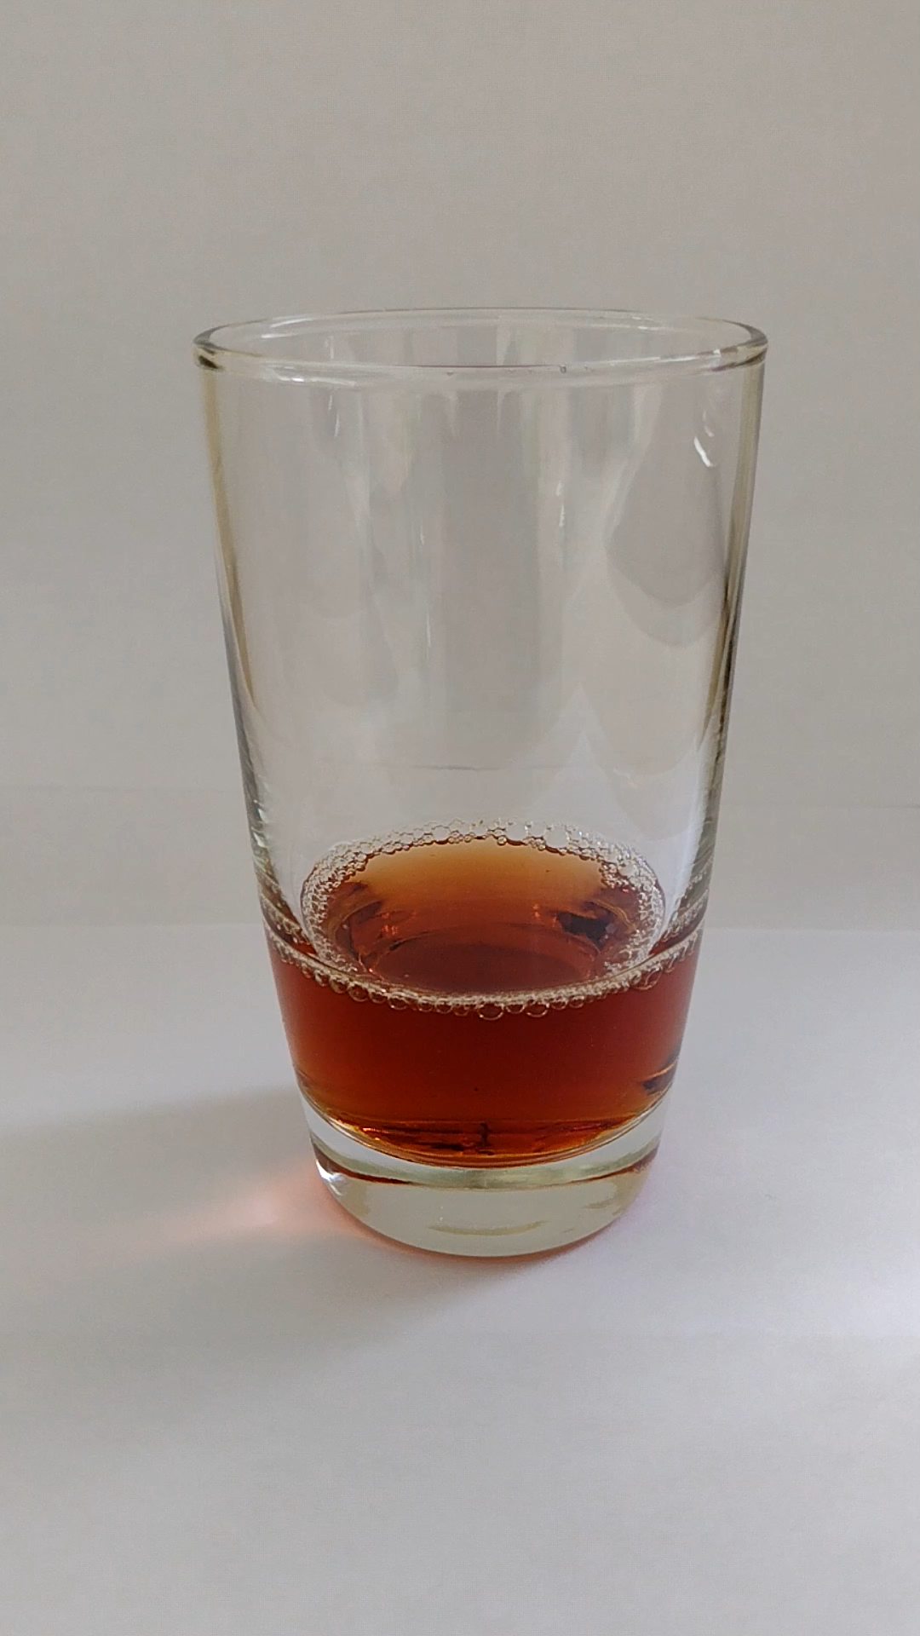
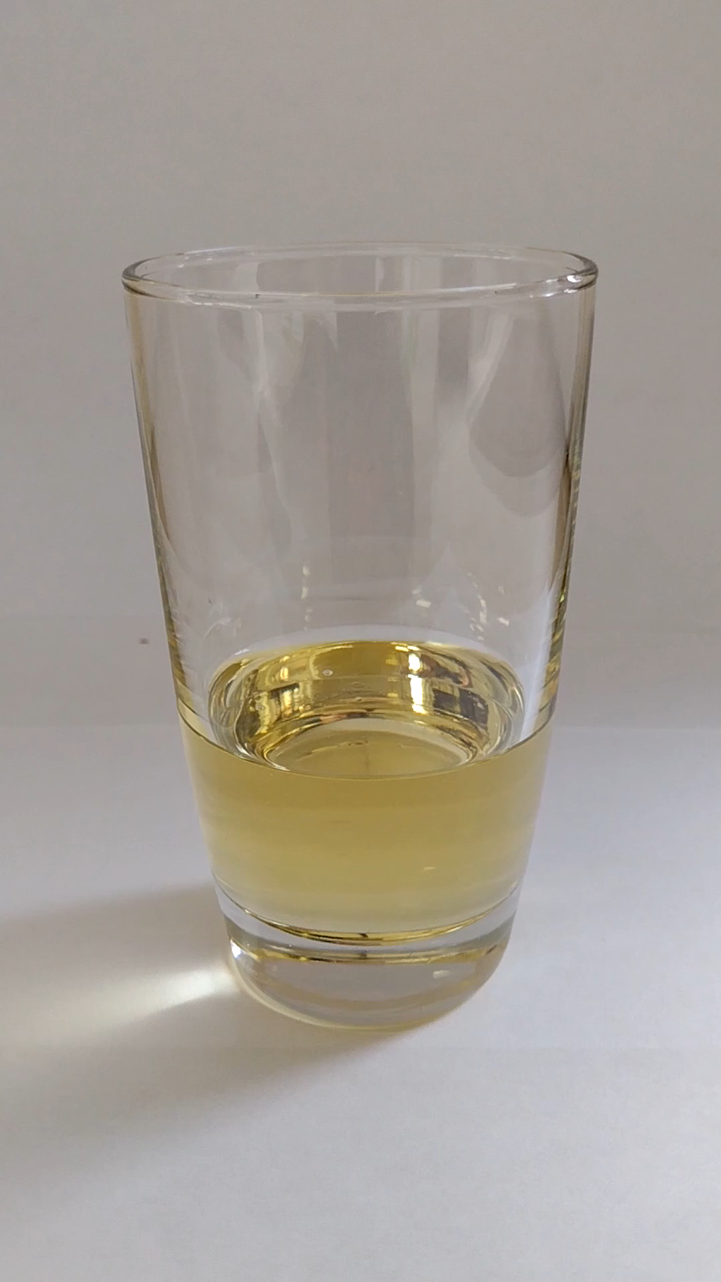
Water and vinegar
Water and oil
Entropy maximized at equilibrium
How are they both maximizing “disorder”?

Slide 4
Which one is more “ordered”?

Slide 5
Which one is more “ordered”?

Slide 6
Since entropy is maximized at equilibrium, if entropy is “disorder” it always has to be clear which configuration “has more disorder”

Slide 7
Since entropy is maximized at equilibrium, if entropy is X it always has to be clear which configuration “has more X”
… and why equilibrium should maximize X

Slide 8
Entropy (in physics) is information?

Slide 9
Water and vinegar
Water and oil
Entropy maximized at equilibrium
How are they both maximizing “information”?

Slide 10
Which one has more “information”?

Slide 11
Which one has more “information”?

Slide 12


Gas at 100 C
Gas at 1000 C
$$S_{100}$$
$$S_{1000}$$

Slide 13
Gas at 100 C
Gas at 1000 C
What is the entropy of this preparation?
50%
50%
$$S_{100}$$
$$S_{1000}$$

Slide 14


Gas at 100 C
Gas at 1000 C
What is the entropy of this preparation?
50%
50%
$$S_{100}$$
$$S_{1000}$$
1) The average $\frac{1}{2}S_{100}+\frac{1}{2}S_{1000}$
2) It’s “one bit” over the average: $\frac{1}{2}S_{100}+\frac{1}{2}S_{1000}+1 bit$
3) It’s entropy of the mixed distribution: $S\left(\frac{1}{2}ρ_{100}+\frac{1}{2}ρ_{1000}\right)$
$$\frac{1}{2}S_{100}+\frac{1}{2}S_{1000}≤S\left(\frac{1}{2}ρ_{100}+\frac{1}{2}ρ_{1000}\right)≤\frac{1}{2}S_{100}+\frac{1}{2}S_{1000}+1 bit$$

Slide 15

It’s better to say “I don’t know” than pretending to have answers
Entropy is not the only case in physics where we pretend to have answers:
Mass is the resistance of a body to acceleration… what about the photon?
The Lagrangian is kinetic energy minus potential energy… what about magnetism?
$$ℒ=\frac{1}{2}mv^{2}+qv⋅A−qV$$
If you get used to accepting vague answers that do not always work, you are never going to find the ones that do

